Slide 1
Asynchronous JavaScript or How to avoid Callback Hell

Slide 2

Mihails Semjonovs
Currently working in “Accenture”
Overall worked over 9 years
Experienced in both: front and back-end

Slide 3

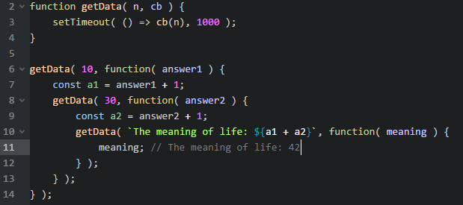
Callback Hell

Slide 4
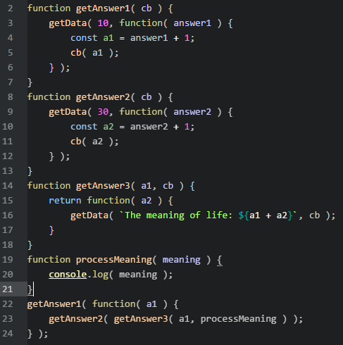
Callback Hell

Slide 5
2 Major Callback Problems:
Inversion of control ( lack of it )
Not mind setted / designed
We can’t trust resources
To early
To late
Multiple times
Not a single time
Lost context
Swallow errors
…
We need to switch to different parts of our code to find how it works
We have to remember what’s happened before

Slide 6

Callback Hell Example

Slide 7
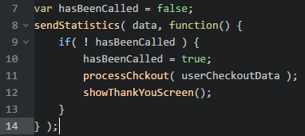
Callback Hell Example

Slide 8
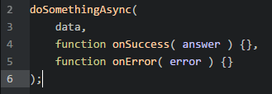

Non fixes
Multiple callbacks – one for response one for error
Error first ( node style ) error callbacks

Slide 9
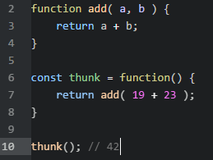
Thunks
In a sync flow thunk is a pure function that needs no parameters to be passed to give you result

Slide 10
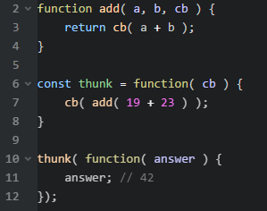
Thunks
In a async flow thunk is a pure function that needs no parameters, except callback, to be passed to give you result

Slide 11
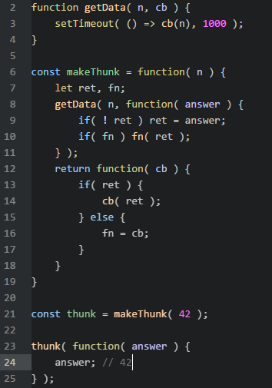
Thunks
Are not solving “Callback Hell” in any way
Understanding thunks you’ll understand Promises

Slide 12
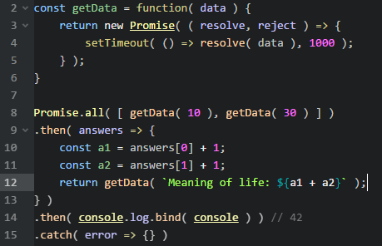
Promises
Introduced in es6 ( es2015 )
Fixes all the trust issues
Has fancy api ( comparing to thunks )
Doesn’t fixes “mind” problem

Slide 13
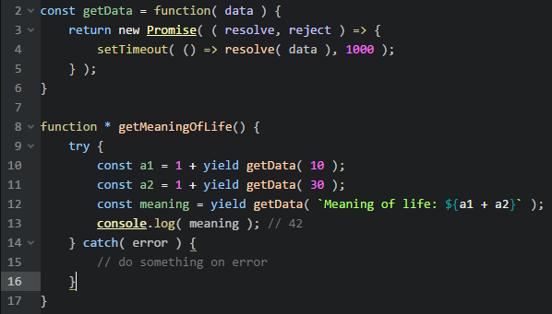
Generators
Usually you would wrap it around some runner (asynquence, co atc.)
They are fixing both issues with callback

Slide 14
Observables

Slide 15
CSP

Slide 16
Async/await

Slide 17
Questions ?

